Slide 1
Power System Fault Detection and Classification
CAPSTONE PROJECT
Presented By:
Subham Mandal - KALINGA INSTITUE OF INDUSTRIAL TECHNOLOGY-Electronic and computer science engineering

Slide 2
OUTLINE
Problem Statement
Proposed Solution
System Development Approach
Algorithm & Deployment
Result
Conclusion
Future Scope
References
IBM Certifications

Slide 3
Problem Statement
Faults in a power distribution system can significantly impact the stability and reliability of the electrical grid. These faults include line-to-ground, line-to-line, and three-phase faults. Traditional methods for fault detection and classification are often time-consuming and require manual interpretation.
The challenge is to design a machine learning model that can detect and classify such faults automatically using electrical measurement data such as voltage and current phasors.

Slide 4
Proposed Solution
The proposed system leverages a supervised machine learning model to detect and classify power system faults using features like voltage and current values. The solution includes:
Data ingestion from a fault dataset (Kaggle)
Preprocessing and feature extraction
Training classification models (e.g., Decision Tree, Random Forest, SVM)
Evaluating model performance
Deploying the model using IBM Cloud Lite services

Slide 5
System Approach
System Requirements:
IBM Cloud (Lite Version)
Python 3.x
IBM Watson Studio
Jupyter Notebook
Libraries Required:
pandas, numpy, matplotlib, seaborn
scikit-learn
IBM Watson Machine Learning SDK

Slide 6
System Approach
Development Steps:
Collect dataset from Kaggle
Preprocess and encode the data
Select relevant features and apply scaling
Train and evaluate machine learning models
Deploy the model on IBM Cloud

Slide 7
Algorithm & Deployment
Algorithm Chosen: Random Forest Classifier
Reason for Selection: Performs well on classification tasks, robust to overfitting, interpretable, handles class imbalance
Input Features:
Phase voltages: Va, Vb, Vc
Phase currents: Ia, Ib, Ic
Target label: Fault type
Training Process:
Train-test split (80:20)
GridSearchCV for hyperparameter tuning
Evaluation metrics: Accuracy, Precision, Recall, F1-score

Slide 8
Algorithm & Deployment
Deployment:
Model saved as .pkl file
Deployed using IBM Watson Machine Learning
API created using IBM Cloud Functions or IBM App Runtime

Slide 9
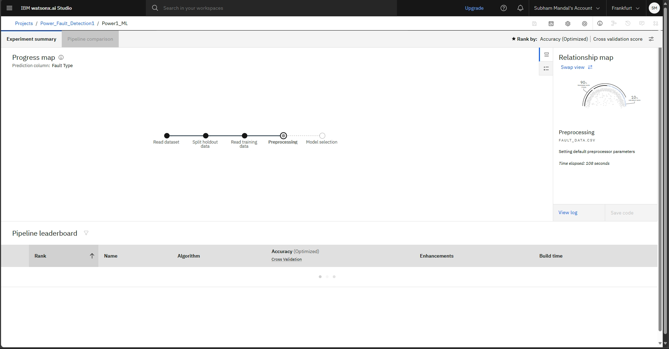
Result

Slide 10
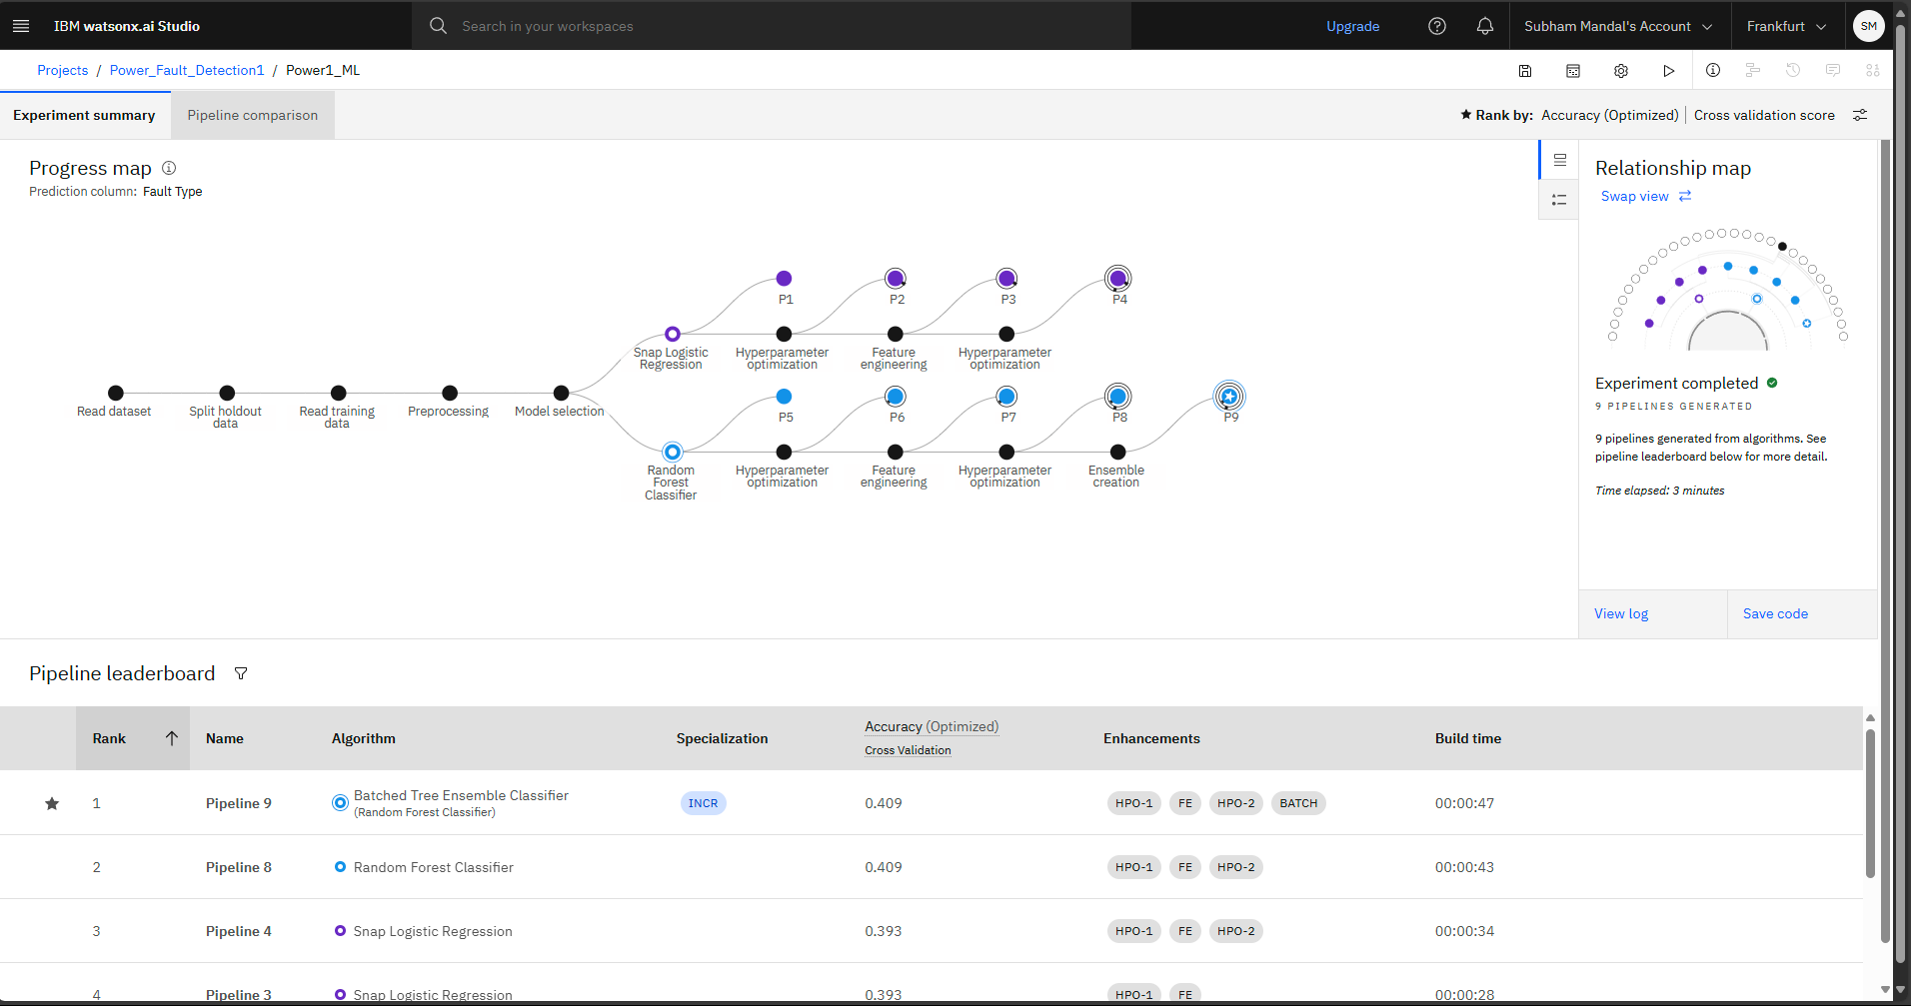
Result

Slide 11
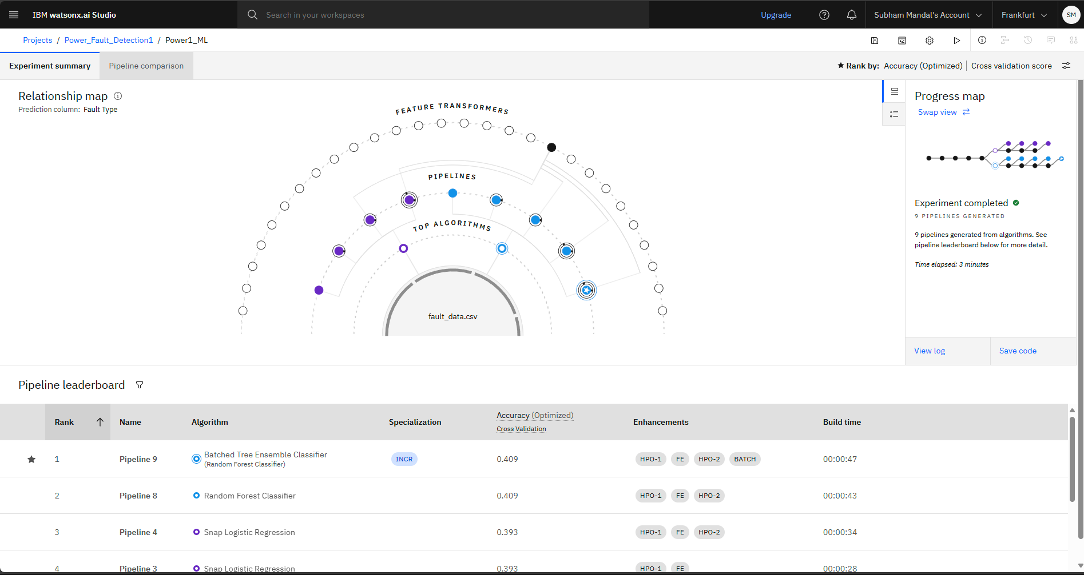
Result

Slide 12
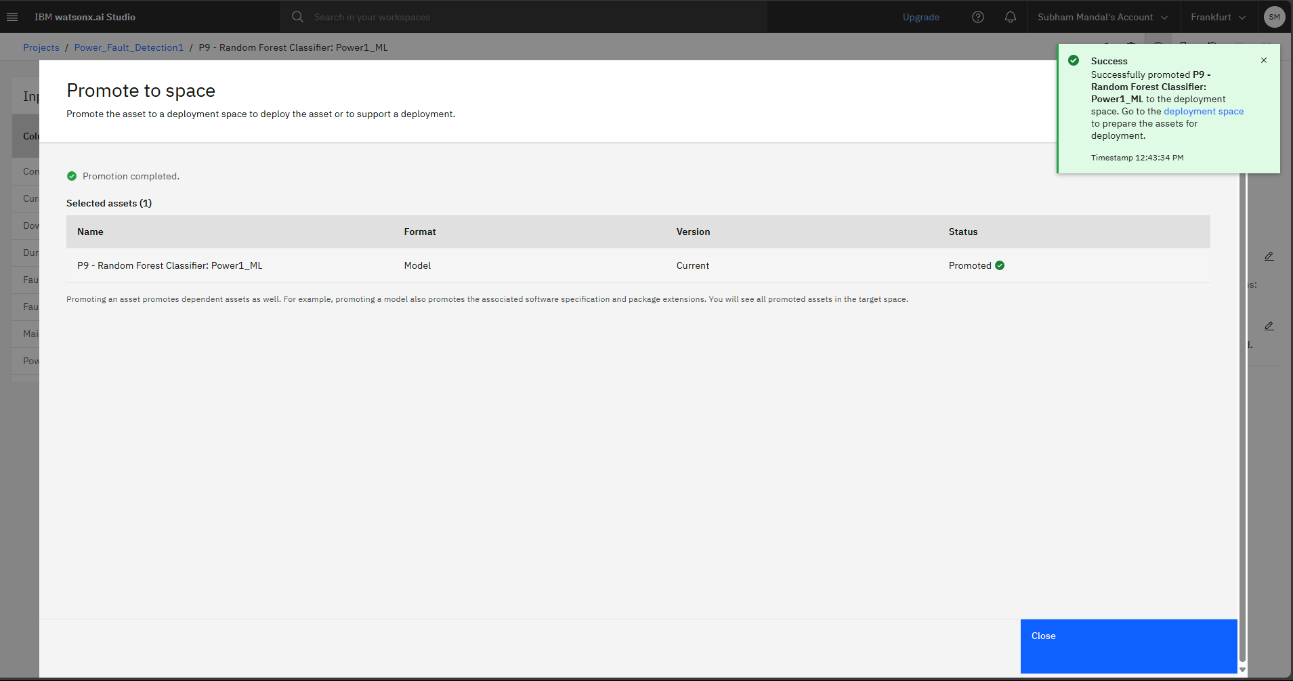
Result

Slide 13
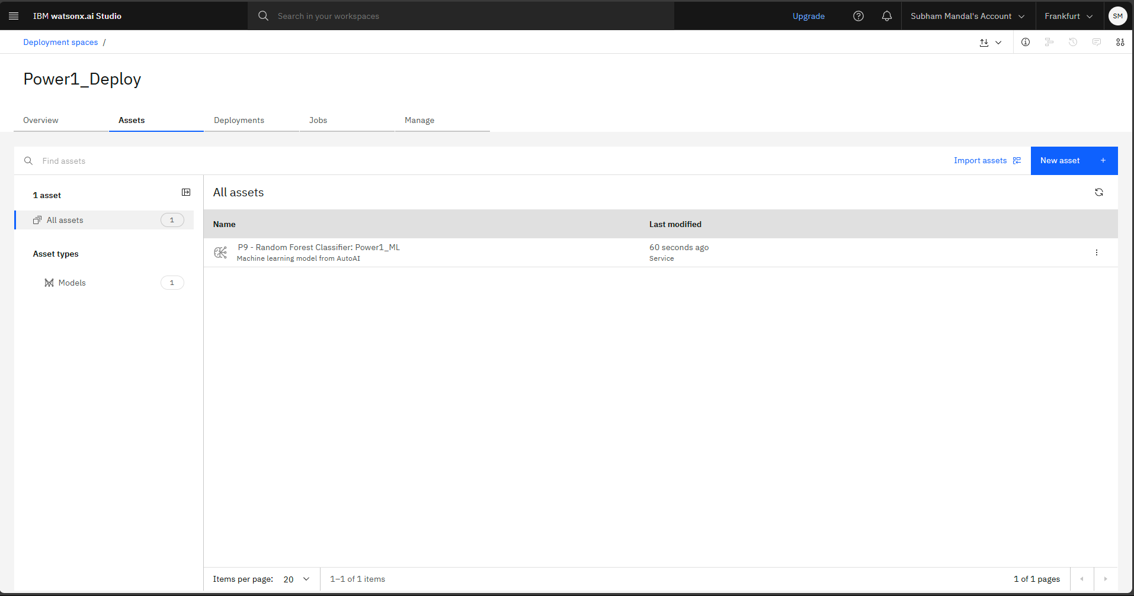
Result

Slide 14
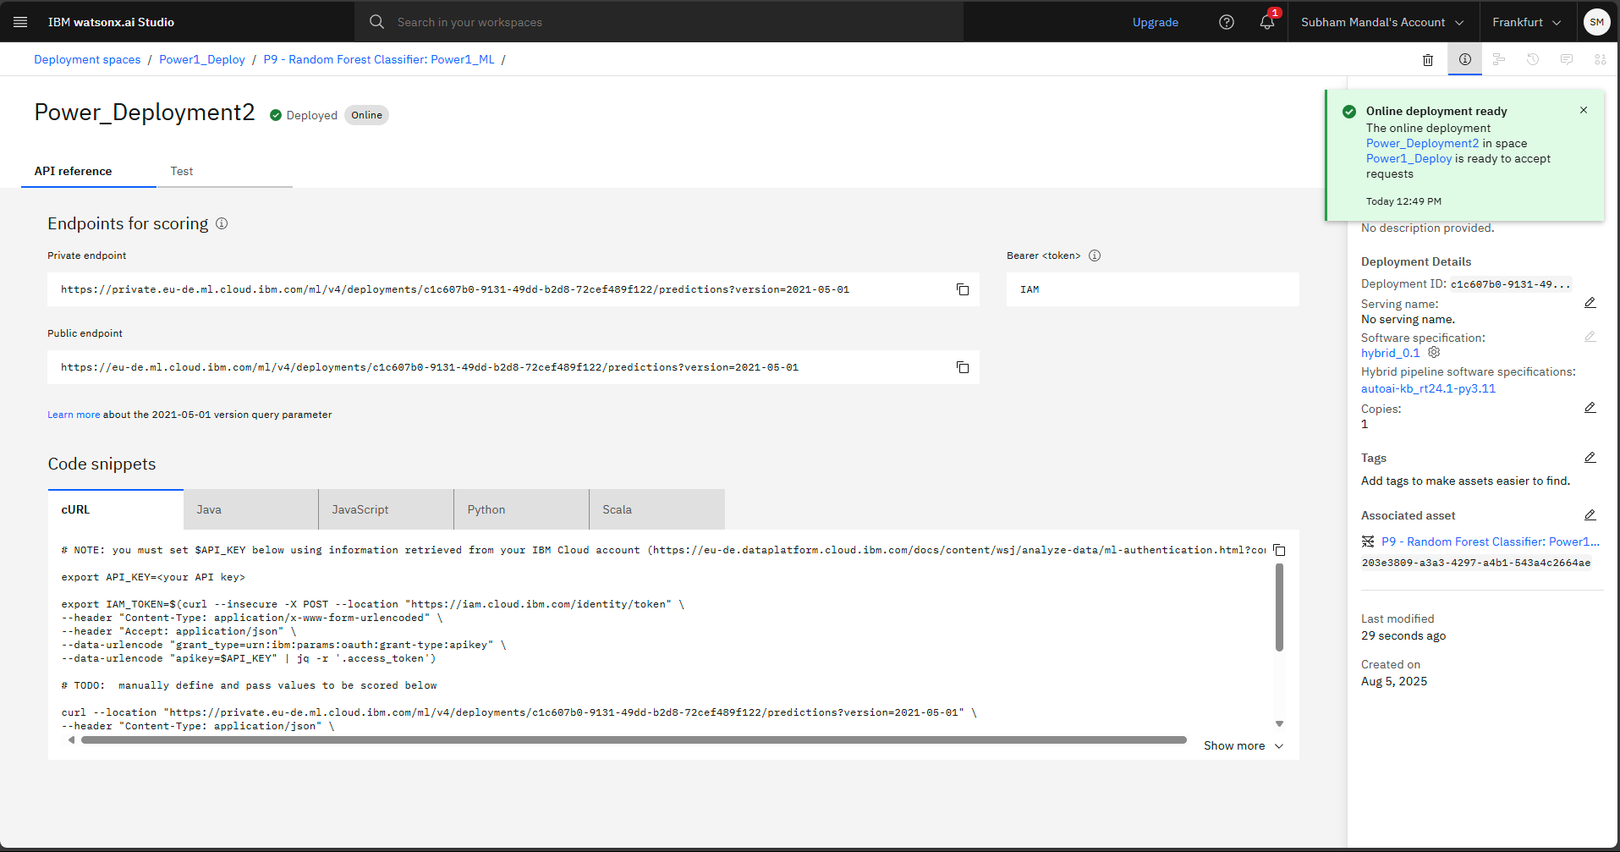
Result

Slide 15
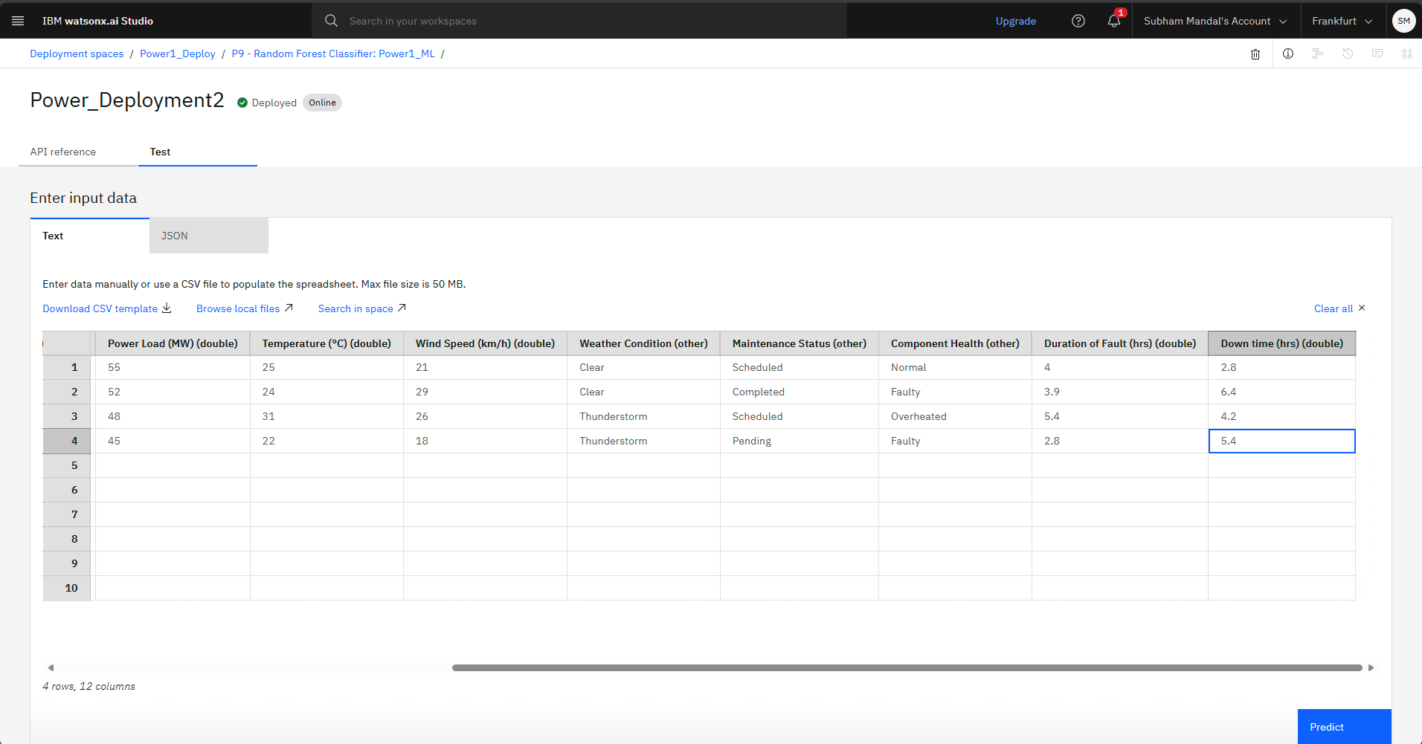
Result

Slide 16
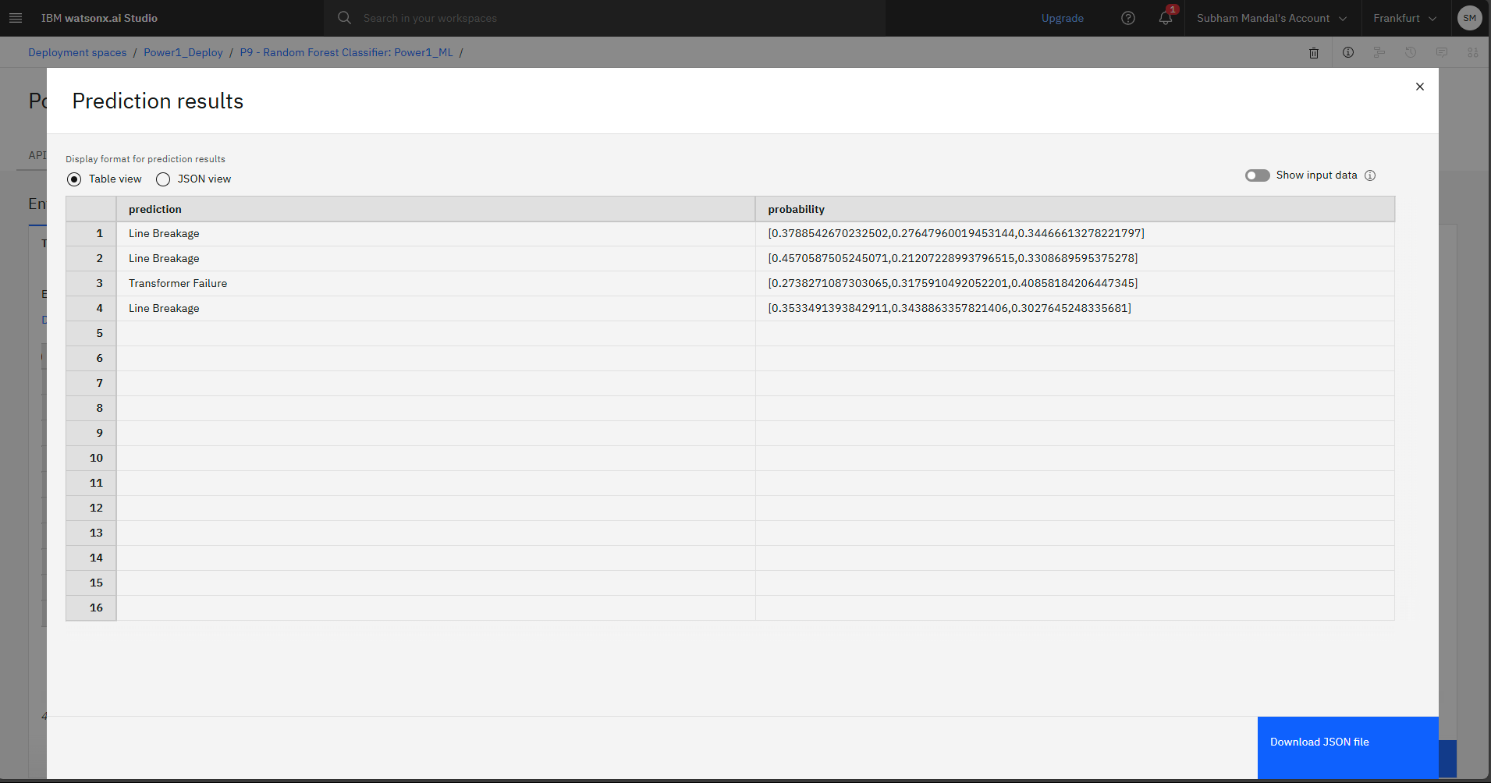
Result

Slide 17
Conclusion
The developed machine learning model successfully classifies power system faults using supervised learning techniques with high accuracy, demonstrating strong potential for real-world application. Integration with IBM Cloud enhances the solution’s scalability and ease of deployment. The experiment shows that cloud-based ML models can significantly reduce fault detection time. This improvement contributes to faster response, better maintenance planning, and overall grid reliability. The approach proves both technically feasible and practically impactful. Thus, the project validates the use of ML in modern power systems for enhanced fault management.

Slide 18
Future scope
Integrate with real-time sensors (IoT)
Extend to multi-region large-scale power systems
Apply deep learning models (LSTM, CNN) for time-series based fault prediction
Integrate with SCADA systems for industrial use
Implement alert mechanisms using IBM Cloud functions

Slide 19
References
Power System Faults Dataset – Kaggle
https://www.kaggle.com/datasets/ziya07/power-system-faults-dataset
Scikit-learn Documentation
IBM Cloud Documentation
IEEE Research Papers on Fault Detection

Slide 20
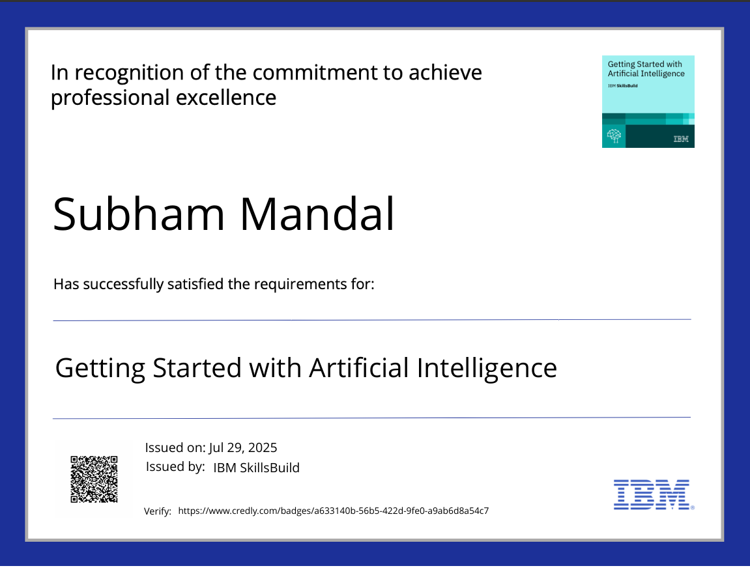
IBM Certifications

Slide 21
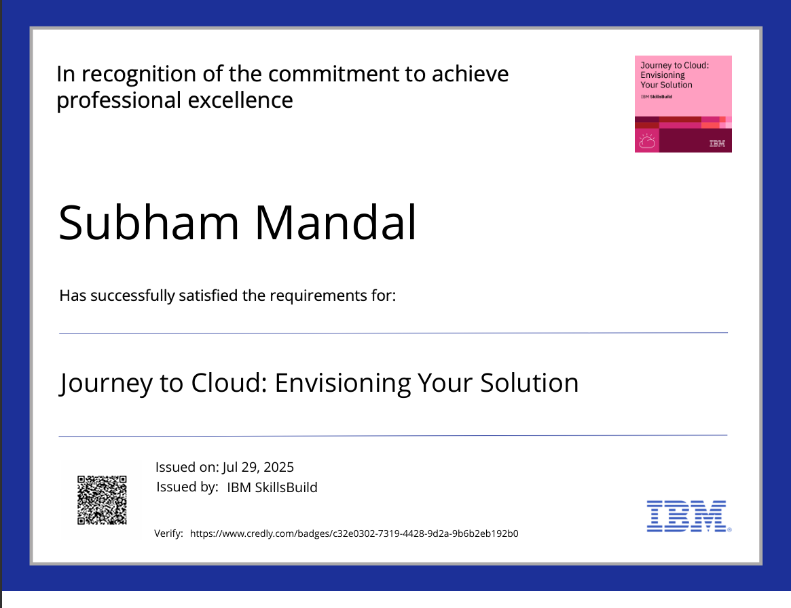
IBM Certifications

Slide 22
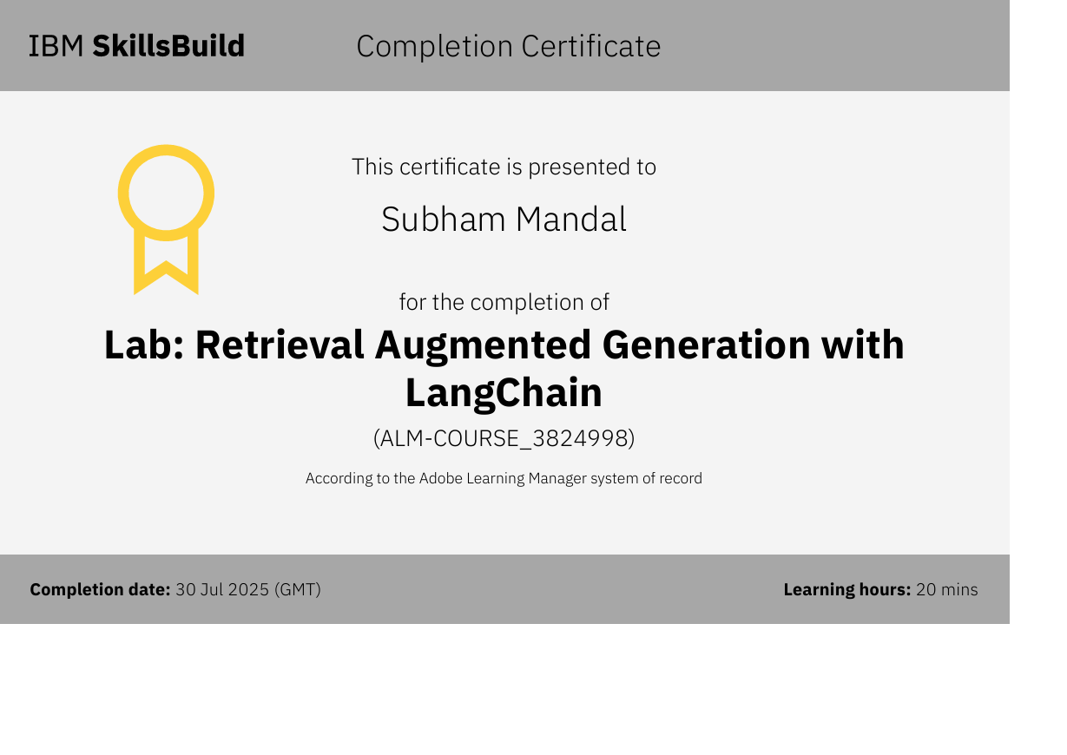
IBM Certifications

Slide 23
THANK YOU

